Slide 1
Cross-disciplinary ontologies for buildings, infrastructure, smart grid, electricity, energy efficiency
Data Spaces Enabling City Digital Twins

Slide 2
Semantic Knowledge Graphs
Knowledge Graphs
Enable large-scale data integration:
Cross-domain data harmonization
Cross-enterprise data integration
Perfect setting for Machine Learning and Data Science
Enable better organization and reusability of DS efforts
Especially "data preparation" efforts
Structure, Storage, Querying, Validation
KGs and Data Spaces
Data spaces use semantics to describe datasets, users, entitlements
But it's also appropriate to define and represent their data as KGs
Highly complementary

Slide 3
Cross-Disciplinary Ontologies/Data Models
Comprehensive ontologies/data models:
Electricity: CIM, CGMES
AECO (Architecture, Engineering, Construction, Operation) of Buildings/Infrastructure:
IFC, LOIN, IDM, ICDD, COINS, MVD, BCF, bSDD
Data Dictionaries, Data Templates, Object Libraries, product catalogs
Bricks Schema, Haystack, Digital Buildings, Real Estate Core
LBD: BOT, BPO, CDC, CTO, DOT, FOG, OMG
Cadaster/smart city: CityGML, GeoSPARQL, other OGC, ISO 23262 GIS-BIM interop
Energy Consumption/Efficiency: FSGIM, OpenADR, DABGEO, EnergyUse, OEMA, EEPSA, PROSG, SEAS, SEMANCO, DogOnt, ThinkHome
Manufacturing: OPC UA, AutomationML, RAMI, AdminShell
Transport/Logistics: GS1 EPCIS, CBV, WebVoc, Digital Links, TDS identifiers (GTIN, GLN, GRAI, GIAI, GDTN…)
Product classification: COBIE, eClass, IEC CDD, GS1 GPC, UNSPSC...
Generic lighter weight ontologies:
IoT, sensors: SOSA, SSN, WoT TD, DTML, SAREF
Bridging: SAREF4ENER, SAREF4BLDG, SAREF4water

Slide 4
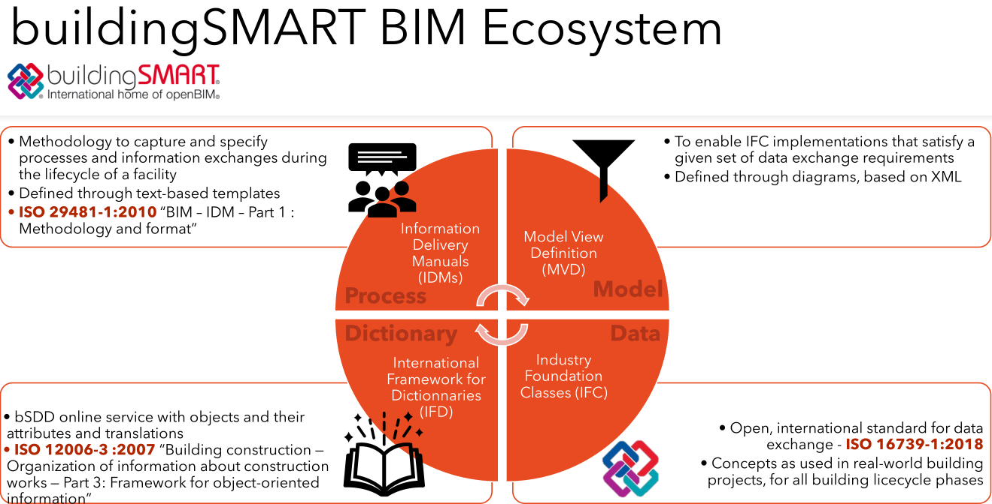

Slide 5
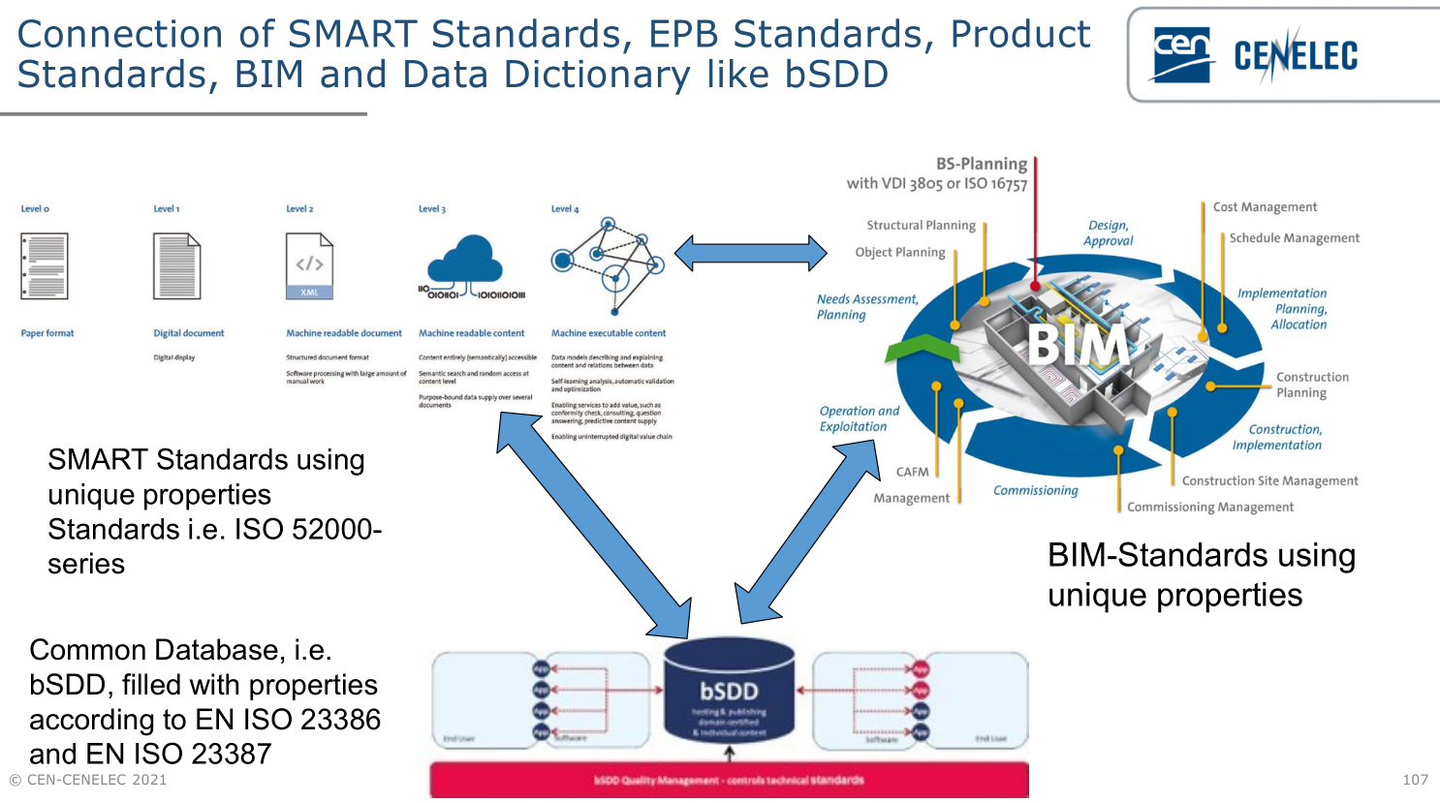

Slide 6
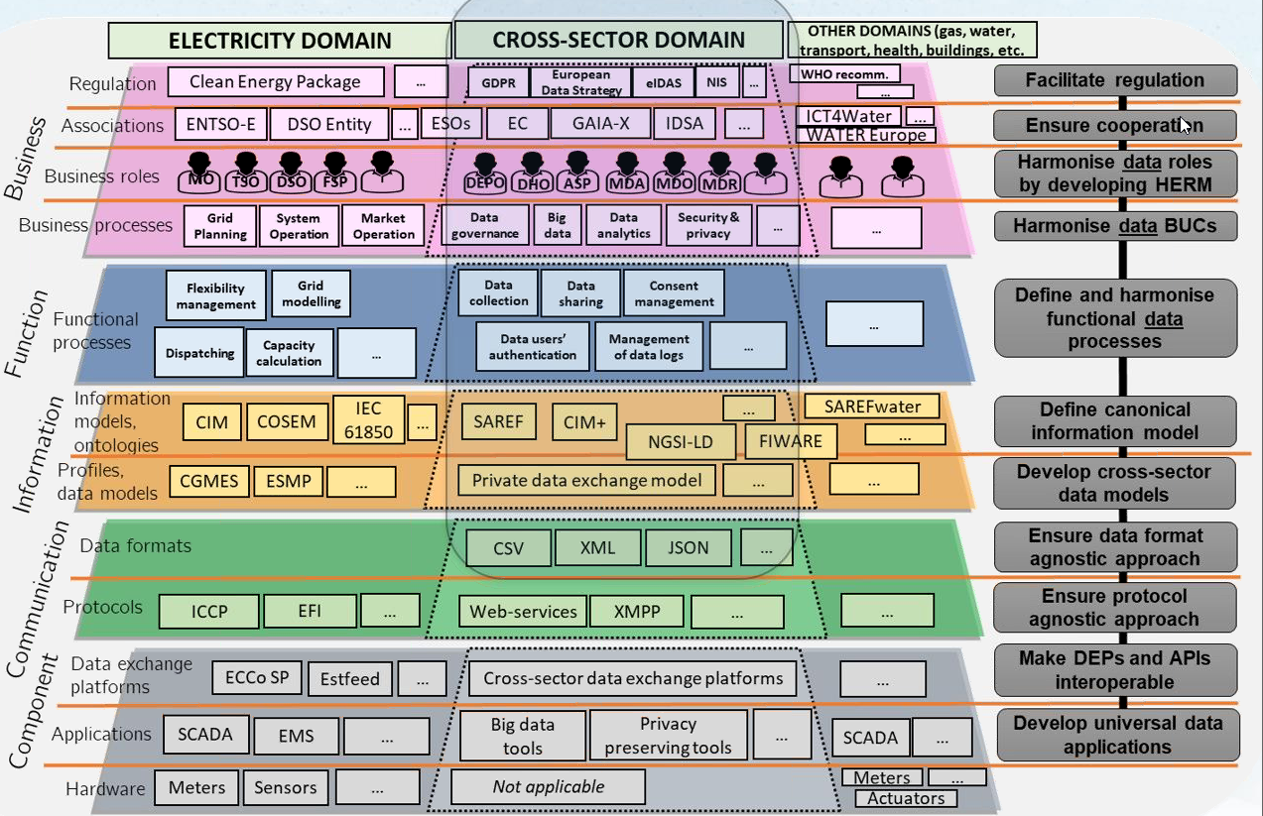
EU Energy Data Exchange Reference Architecture
Source: H2020 projects BRIDGE, BD4NRG

Slide 7
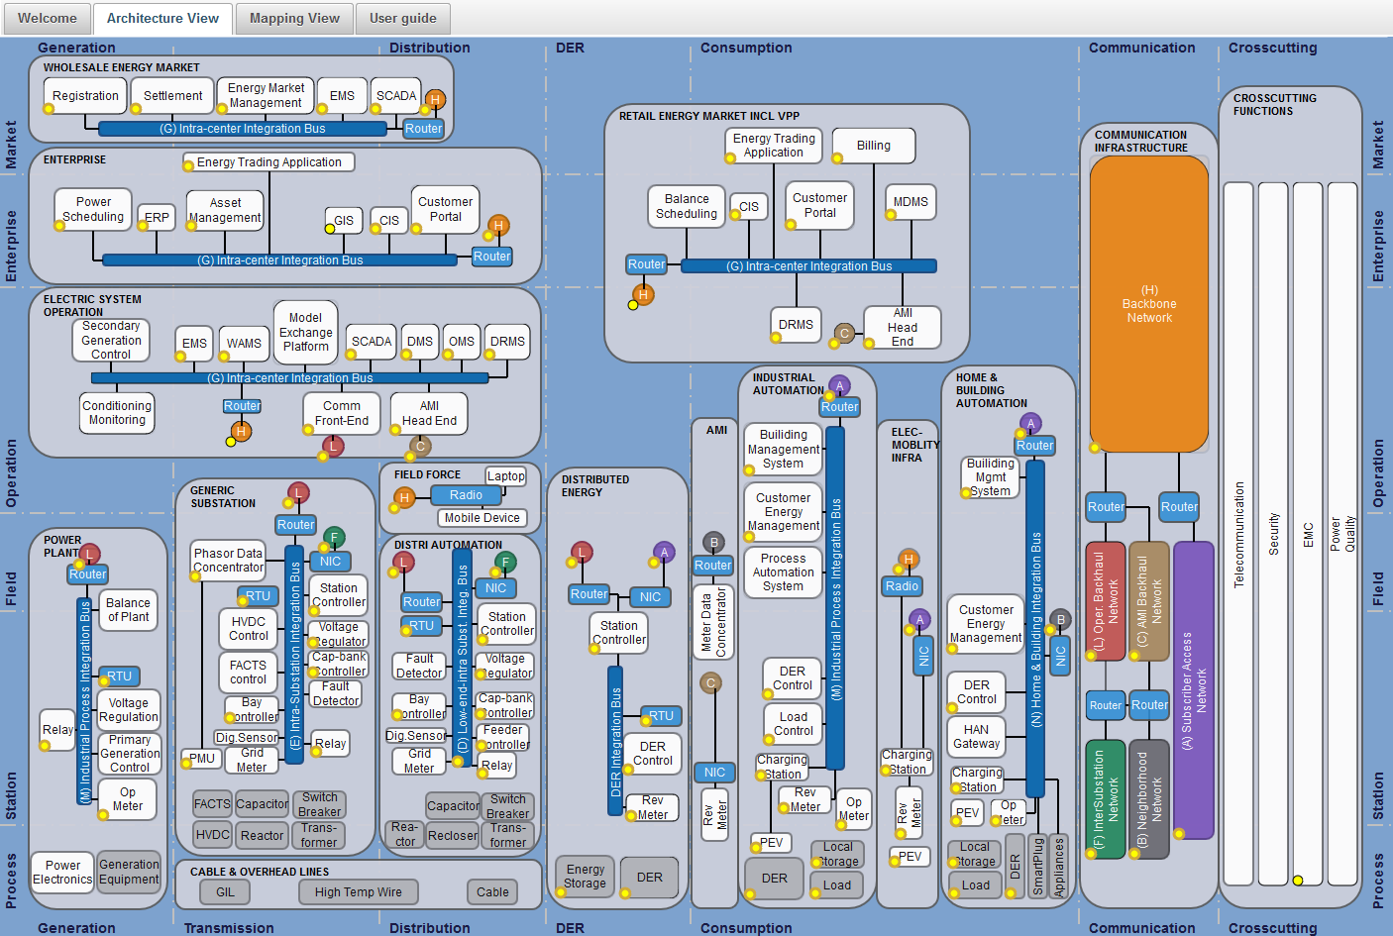
IEC CIM (Common Information Model)
Covers a Lot of the Electricity Enterprise
Diagram: IEC Smart Grid Standards Map

Slide 8
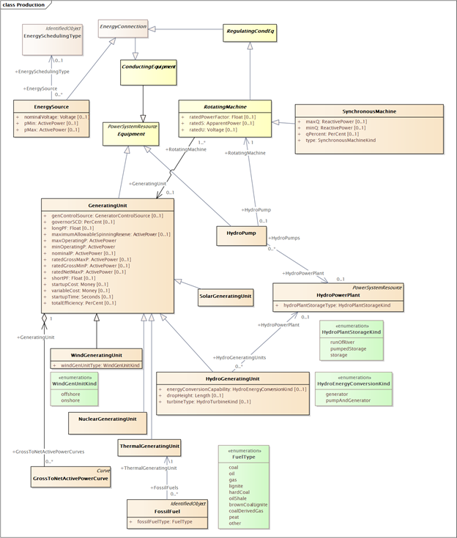
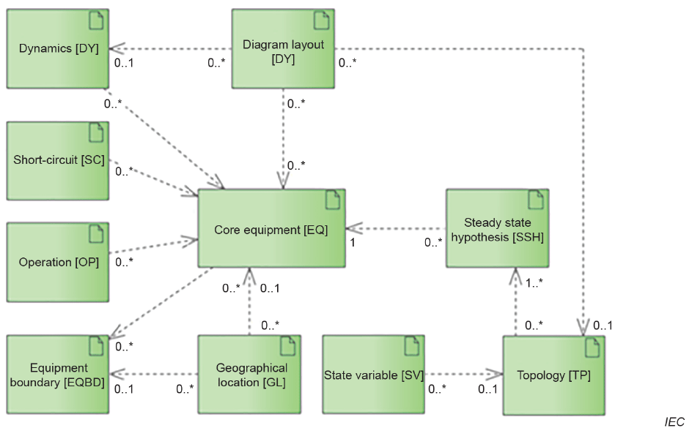
IEC CIM & ENTSO-E CGMES
ENTSO-E Common Grid Model Exchange Standard (CGMES v3)
Basis of information exchange in EU Single Electricity Market
Models maintained in UML
From it are generated ontologies (RDFS) an shapes (SHACL)

Slide 9
Energy Identification Code (EIC)
A global identifier of energy resources and parties
Electricity (ENTSO-E), gas (ENTSO-G).
Distributed issuing/maintenance (like DNS, DOI, GLEI, GS1 GTIN/GLN)
Examples:
10YCA-BULGARIA-R: Bulgaria (control zone, bidding area, member state)
10XBG-ESO------A: Elektroenergien Sistemen Operator (BG TSO)
32XNPP-KOZLODUY2: NPP Kozloduy company (balance responsible party)
32W001100100217D: NPP Kozloduy reactor G10 (production unit, i.e. power station)
32W001100100017L: Kozloduy reactor G10 (generating unit)
Excellent foundation for a global Energy KG
Unfortunately, CIM uses RDF only for RDF XML data exchange
EIC are not used in RDF nodes, instead temporary GUIDs are generated on export
If CIM complied with Linked Data principles that would make energy data sharing much easier

Slide 10
Energy Efficiency: DABGEO Ontologies
Actor
Actuator operation
Actuators
Air conditioning systems
Air pollutants
Appliance Demand Response
Appliance category
Appliance phases
Appliance working mode
Building element actuators
Building element sensors
Building elements structure
Building energy performance indicators
Building energy performance requirements
Building environmental parameters
Building geometrical parameters
Building orientation
Building parameters
Building physical elements
Building spaces environmental
Building structural parameters
Building structure
Building typology
Business process
Business process energy performance
Climate type
Communication devices
Cooking devices
Device
Device actuators
Device commands
Device field of application
Device flexibility
Device functionality
Device manufacturer
Device operation
Device power profile
Device preferences
Device state
Distributed energy sources
Distributed energy sources state
District energy generation systems
Domotic network components
Emission indicators
Energy Consumption Systems Operation
Energy capacity
Energy consumption systems
Energy consumption systems field of application
Energy cost indicators
Energy efficiency indicators
Energy external factors
Energy generation systems functionality
Energy generation systems performance
Energy key performance indicators
Energy market roles
Energy parameter
Energy provider
Energy reduction measures
Energy saving posts and discussions
Energy storage systems
Energy usage
Energy usage cost
Energy usage forecast
Entertainment equipment
Environmental factors
Environmental sensors
Equipment design parameters
General use brown goods
Household socio-economic factors
Individual socio-economic factors
Individual user
Infrastructure
Infrastructure location
Infrastructure premise
Metering/actuation equipment
Organization
Organization activity
Organization internal structure
Organization members
Organization travel
Populated places
Population socio-economic factors
Provided energy type
Refrigeration devices
Renewable energy indicators
Security systems
Sensor configuration
Sensor operation
Socio-economic factors
Stakeholders infrastructure
System actors
User preferences
Ventilation systems
Water heating white goods
Weather
Weather report
Weather-related environmental factors
10

Slide 11
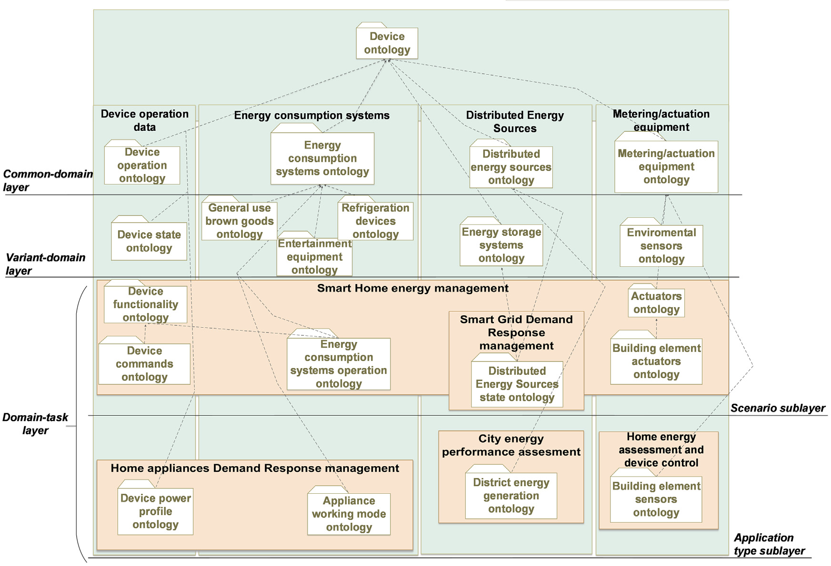
DABGEO Energy Equipment Domain
Source: "DABGEO: A reusable and usable global energy ontology for the energy domain" (JWS 2020)

Slide 12
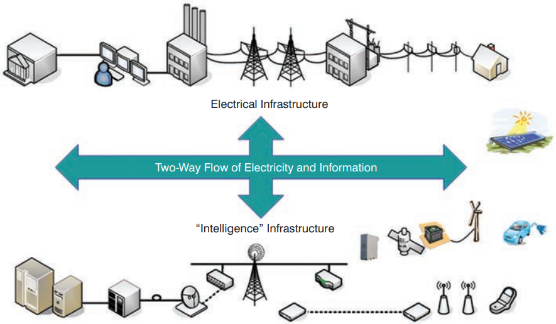
Facility Smart Grid Information Model (FSGIM) Context
Source: "Information Model Standard for Integrating Facilities with Smart Grid" (ASHRAE Journal, 2011-11)

Slide 13
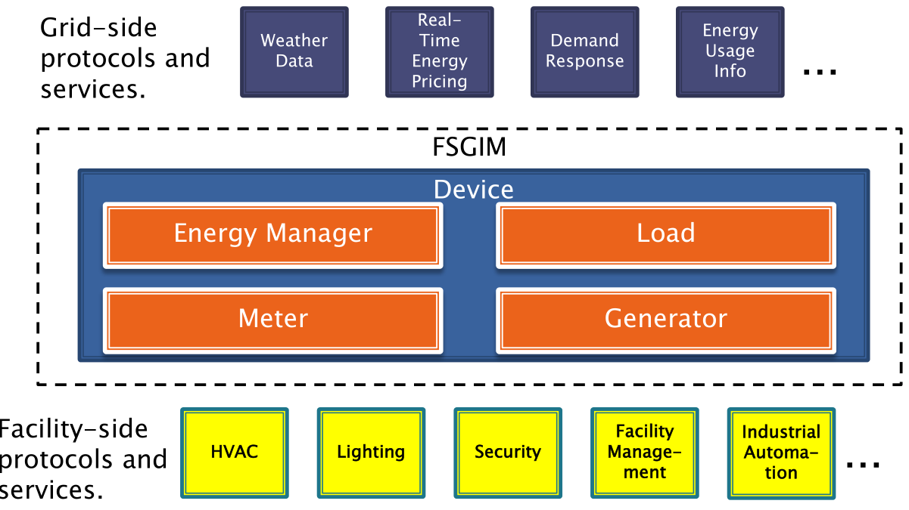
Facility Smart Grid Information Model (FSGIM) Scope
Source: ASHRAE presentation to US DOE (2014-05)
Closely related: OpenADR

Slide 14
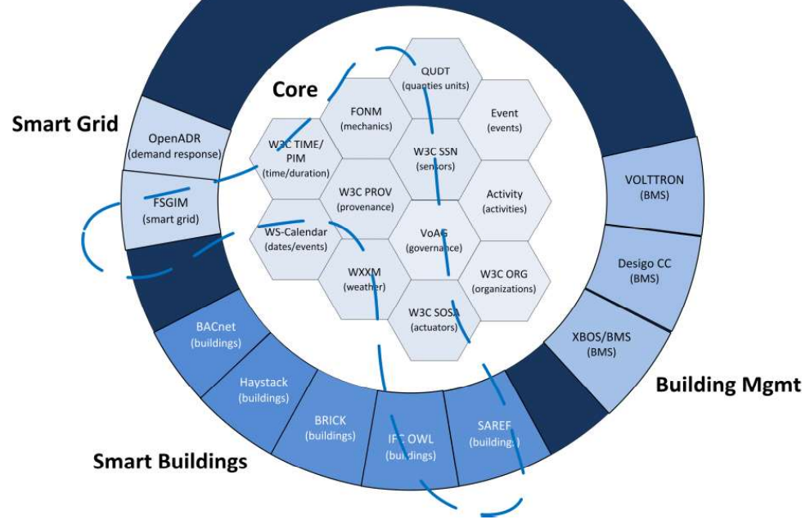
Example: Layering and "Mixing" of Ontologies
Source: "Smart Grid-Building Semantic Integration for Interoperability" (WLS 2019)

Slide 15
Thank you! Vladimir Alexiev Chief Data Architect, Ontotext

